Slide 1
Auditing the School Retirement Plan -
Let’s talk!
PRESENTATION BY Nebraska public employees retirement systems INTERNAL AUDIT
NASBO CONFERENCE APRIL 21, 2021

Slide 2
NPERS INTERNAL AUDIT
INTRODUCTIONS
THEME FOR TODAY Following school retirement plan requirements
Internal Audit
Taking proactive steps to cut down on errors and confusion
When it’s your school’s turn for an audit – then what?
Working through the audit process
Analyzing employee hours
Calculating a monthly average of 20 hours or more per week in each calendar month
Q & A Box

Slide 3
INTERNAL
AUDIT
TEAM
TIM BAKER Internal Auditor Manager
  402-471-2056
  tim.baker@nebraska.gov
JONATHAN NEWCOMB Internal Auditor
  402-471-7075
  jonathan.newcomb@nebraska.gov
VANESSA HOHLEN Internal Auditor
  402-471-8763
  vanessa.hohlen@nebraska.gov

Slide 4
THEME FOR THE DAY
FOLLOWING SCHOOL RETIREMENT PLAN REQUIREMENTS

Slide 5
INTERNAL AUDIT
Following good internal controls, NPERS reviews school payroll records to ensure all eligible employees enroll in the Plan, the proper amount of contributions are withheld and reported, and employee information is documented and accurate.
Taking proactive steps to cut down on errors and confusion.

Slide 6
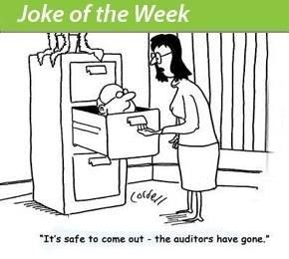

Slide 7
I received my Initiation Audit Letter Now What?
  Why (Nebraska Revised Statute. 84-1503.04,)
  Contact Information
  Due date for reply
  Audit checklist (organization of materials)
    Prefer documentation to be received electronically
    Protect PII
    Reduce Follow ups
    What's usually missing

Slide 8
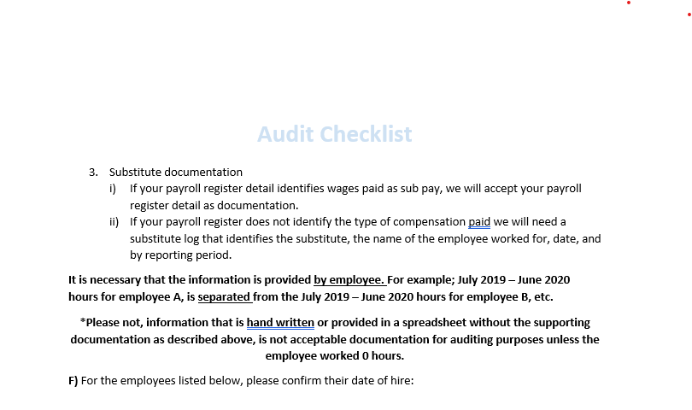
Example Checklist

Slide 9
School employer Questionnaire
Page 1 SCHOOL BACKGROUND INFO
Part A Plan enrollment of employees
Part B wage & contributions
Part C Internal controls info
Final Audit Letter
  What we found and what to do
  20 days

Slide 10
Analyzing employee hours
Let’s first define the different categories of employees for retirement purposes
        Substitute employee
        Regular/permanent employee
        Temporary employee

Slide 11
SUBSTITUTE EMPLOYEE
Who is a substitute employee for retirement purposes?
Who is not a substitute employee for retirement purposes?

Slide 12
What is the difference?
Who is a substitute
Who is not a substitute
A person hired by a public school (or ESU) as a temporary employee
To assume the duties of a regular employee
Due to a temporary absence of any regular employee
A person hired by a public school (or ESU) as a regular employee
On an ongoing basis
And assume the duties of other regular employees who are temporarily absent
In other words: A substitute IS NOT a permanent substitute!

Slide 13
A is hired by a school district to temporarily fill in for regular employees when they are temporarily absent. A does not work any extra duties for the employer and will sit by the phone and wait for a call to come to work. A is a substitute employee.
Does the employer need to track hours for A?
No, substitutes are not eligible for retirement and therefore, there is no reason to track hours.
Yes, although the hours are not reportable and A does not qualify for retirement, you must track hours and whom they substitute for. This provides documentation that A is a substitute employee. The hours tracked are also needed should this employee pick up extra ongoing, regular hours.
No, hours are never tracked for substitutes. We pay them and track them on a days worked basis.
No, I track who they substituted for, but there is no need to track hours.

Slide 14
Correct answer:
B. Yes, although the hours are not reportable and A does not qualify for retirement, you must track hours and whom they substitute for. This provides documentation that A is a substitute employee. The hours tracked are also needed should this employee pick up extra ongoing, regular hours.

Slide 15
REGULAR/permanent EMPLOYEE
**mandatory participation**
From date of hire
Becomes eligible

Slide 16
Required participation from date of hire
Hired in a regular full-time or part-time position
Who works a full-time or part-time schedule
On an ongoing basis
For 20 or more hours per week

Slide 17
Becomes eligible then mandatory participation
Hired to provide less than 20 hours per week, but
Who ends up providing service for an average of 20 or more hours per week
In any (does not need to be consecutive) 3 calendar months of a plan year (July 1 to June 30)
Once the employee becomes eligible, they are deemed a regular employee for all future employment with the same employer and must begin making retirement contributions with the next payroll period

Slide 18
B is hired as a regular employee to work an average of 20 or more hours a week, but less than 40 hours a week, on an ongoing basis. B is immediately enrolled in retirement and starts contributions. After 3 months of employment, B is asked to pick up occasional shifts for other regular employees who are temporarily absent.
We know it is important to track hours worked for the regular employment so that the correct amount of creditable service is reported.
Does this employer need to track hours for the extra shifts B picks up when other regular employees are temporarily absent?
No, these extra hours are substitute hours, therefore, not it is not eligible compensation for retirement contributions.
No, these extra duty shifts are only logged as days because they are substitute shifts. They do not need to be tracked or reported.
Yes, these hours are not true substitute hours as B is already a regular employee with this employer and contributing to retirement. These hours need to be tracked and added together with the hours worked during B regular employment to ensure the correct amount of creditable service is reported.
Oh geez, this question makes me want to retire!

Slide 19
Correct answer:
C. Yes, these hours are not true substitute hours as B is already a regular employee with this employer and contributing to retirement. These hours need to be tracked and added together with the hours worked during B regular employment to ensure the correct amount of creditable service is reported.

Slide 20
C is hired as a permanent employee to drive a bus 15 hours a week on an ongoing basis. C starts to fill in for other bus drivers when they are temporarily absent.
Again, we already know we need to track the regular ongoing hours spent driving a bus (not bus routes worked.)
Does this employer need to track hours for C when C picks up the additional shifts when temporarily filling in for regular employees who are temporarily absent?
No, these are substitute hours and are therefore not to be included as they do not qualify to be eligible for retirement purposes.
Yes, these additional hours are not true substitute hours as C has a permanent, ongoing position with this employer. These hours need to be tracked and added together with C’s regularly scheduled hours to ensure C is not working an average of 20 or more hours a week in any 3 calendar months of a plan year, which would require C to be enrolled in the plan and begin contributions with the next payroll period.
I feel like there is a theme happening here. Picking this answer because I’m just not sure.
No, hours for substitute shifts are not even tracked because we use days and not hours, therefore it would not make any sense to track hours worked for these shifts.

Slide 21
Correct answer:
B. Yes, these additional hours are not true substitute hours as C has a permanent, ongoing position with this employer. These hours need to be tracked and added together with C’s regularly scheduled hours to ensure C is not working an average of 20 or more hours a week in any 3 calendar months of a plan year, which would require C to be enrolled in the plan and begin contributions with the next payroll period.

Slide 22
D is hired as a regular employee working 40 hours a week. D is immediately enrolled in retirement and starts contributions. After six months, D begins temporarily filling in for regular employees who are temporarily absent.
Part A
Does this employer need to track hours for D’s regular employment?
No, they are already eligible and enrolled in the plan so there is no reason to track and report hours worked. They work over 1,000 hours anyway and will receive a full year of creditable service.
Yes, although the hours worked will be over 1000 hours a year, it is still important to track hours. If something happens in the year where D is unable to work the full year, they need to receive the correct amount of service credit for the portion of the year worked.
No, we just track an average number of hours based on the number of days in the contract and number of days worked that month.
This question seems too simple and I feel like it is a trick question.

Slide 23
Correct answer:
B. Yes, although the hours worked will be over 1,000 hours a year, it is still important to track hours. If something happens in the year where D is unable to work the full year, they need to receive the correct amount of service credit for the portion of the year worked.

Slide 24
D is hired as a regular employee working 40 hours a week. D is immediately enrolled in retirement and starts contributions. After six months, D begins temporarily filling in for regular employees who are temporarily absent.
Part B
Does this employer need to track hours for D’s hours when D fills in for regular employees who were temporarily absent?
This question is giving me a headache.
No, these are substitute hours and are not eligible for compensation under the retirement Plan.
No, because we only need to track days worked and not hours.
Yes, these cannot be considered true substitute hours as D is already a regular employee at this employer and contributing to retirement. These hours also need to be tracked in case something happens in the year where D is unable to work the full year. This will ensure D receives the correct amount of service credit for the portion of the year they worked.

Slide 25
Correct answer:
D. Yes, these cannot be considered true substitute hours as D is already a regular employee at this employer and contributing to retirement. These hours also need to be tracked in case something happens in the year where D is unable to work the full year. This will ensure D receives the correct amount of service credit for the portion of the year they worked.

Slide 26
TEMPORARY EMPLOYEE
LIMITED PERIOD OF TIME – NOT TO EXCEED ONE YEAR
TO ACCOMPLISH A SPECIFIC TASK OR PURPOSE
ONCE TASK IS COMPLETE, THE EMPLOYEE TERMINATES

Slide 27
E is hired by a school district as a substitute to temporarily fill in for regular employees when they are absent. After 4 months, E also picks up hours cleaning the building for 2 hours a day, three days a week, on an ongoing basis. E is no longer a substitute once E starts working on an ongoing basis cleaning the building.
Does this employer need to track hours for E?
I’m confused. Is this question asking if the employee is a substitute and starts picking up extra ongoing shifts, do I need to track hours for the substitute position and/or the extra shifts? No. Substitute is not eligible and the other shifts are not eligible because it’s only 6 hours a week.
No, substitutes are not eligible and I only track the days worked. The other hours are not enough to track.
Yes, as E now has a permanent position cleaning the building for 2 hours a day, E can no longer be just a substitute employee. All hours for both positions must be tracked to ensure timely and proper enrollment in retirement if B works an average of 20 or more hours a week in any 3 calendar months of the plan year (July 1 to June 30).
No, the employee is a substitute first which makes all hours ineligible for retirement purposes.

Slide 28
Correct answer:
C. Yes, as E now has a permanent position cleaning the building for 2 hours a day, E can no longer be just a substitute employee. All hours for both positions must be tracked to ensure timely and proper enrollment in retirement if B works an average of 20 or more hours a week in any 3 calendar months of the plan year (July 1 to June 30).

Slide 29
THEME OF ANALYZING HOURS
Regardless of category, all employees must have their hours tracked every time they render service, at the time they render service, to ensure they receive the correct retirement benefit!

Slide 30

Let’s do some math together!
Get ready for polling question #6

Slide 31
F is hired by a school district to work part-time. Most weeks he works under 20 hours a week, but during the busy months, he can work over 20 hours a week.
How do you do the calculation to determine if he is over the average of 20 or more hours a week in any 3 calendar months of a plan year (July 1 to June 30)?
Each work week has to be 20 or more hours for me to consider it an eligible month.
I take the total number of hours worked in the month, divide that by the actual number of days in the month, and multiply that by 7 to get the average number of hours worked in the month.
I use my payroll calendar to make the determination. If they have more than 80 hours for the payroll detail, regardless if there are other months within the payroll cycle that month, then that is an eligible month.
I take out any non-working days within the month and divide the total number of hours by how many weeks are actually worked in the month.

Slide 32
CORRECT ANSWER
Take the number of hours worked in one calendar month
Divide that by the actual days in the calendar month
Multiply that by 7 (days in the week)
Equals the number you need to use in determining the average hours worked in one calendar month
These do not need to be consecutive months!!

Slide 33
Let’s look at an example for February 2020
Take the number of hours worked in one calendar month – 82.50
Divide that by the actual days in the calendar month – 29
Multiply that by 7 (days in the week)
Your total of average hours worked per week in the calendar month – 19.913
  82.50 hours / 29 days in February X 7 = 19.913 average hours worked in a week in February

Slide 34
Change it up slightly by adding only 30 extra minutes worked anytime in the month
Original – NOT ELIGIBLE
  82.50 hours / 29 days in February X 7 = 19.913 average hours worked in a week in February
Adding 30 minutes - ELIGIBLE
  83 hours / 29 days in February X 7 = 20.03 average hours worked in a week in February

Slide 35

New Extra Duty and substitute tracking forms arriving soon!!!
Monthly extra duty log
Extra duty log worksheet
Monthly substitute log
Substitute log worksheet
**We strongly encourage you to distribute these to staff for them to fill out and return to you for necessary documentation

Slide 36
Question / answer

